Slide 1
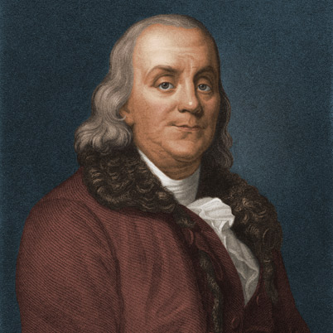
PHYS 2210
Lecture # 2
Vern Hart PhD
vhart@uvu.edu
“Never confuse motion with action.”
-Benjamin Franklin

Slide 2


POD
Assume:
$$\overline{A}=(A_{x},A_{y},A_{z})$$
$$\overline{B}=(B_{x},B_{y},B_{z})$$
$$\overline{C}=(C_{x},C_{y},C_{z})$$
Derive an expression for:
$$\overline{A}x(\overline{B}x\overline{C})$$
$$\overline{B}(\overline{A}·\overline{C})−\overline{C}(\overline{A}·\overline{B})$$

Slide 3
What is motion?

Slide 4
Fact:
Motion is relative

Slide 5
Question:
What do we mean when we say something is relative?

Slide 6
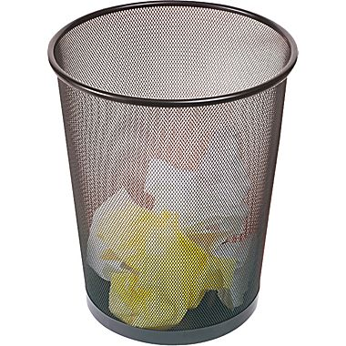
How fast are you moving right now?

Slide 7
What does relative mean?
Definition:
A relative quantity is measured differently by each observer
It is relative to their reference frame

Slide 8
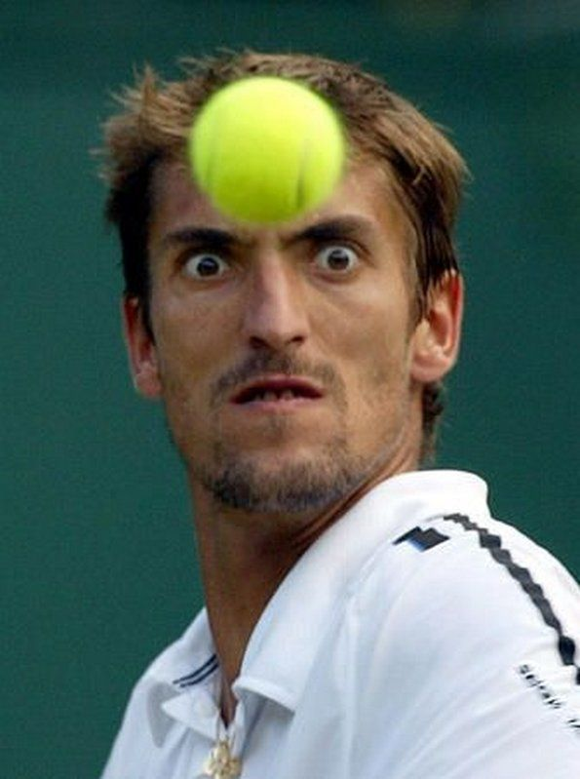
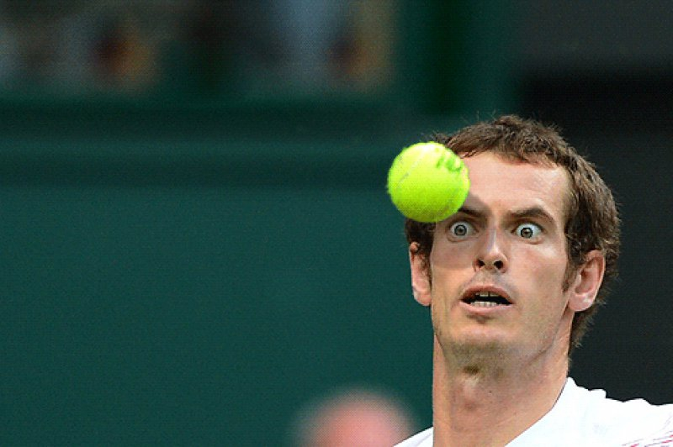
Vengeance
Story Time
Betrayal

Slide 9


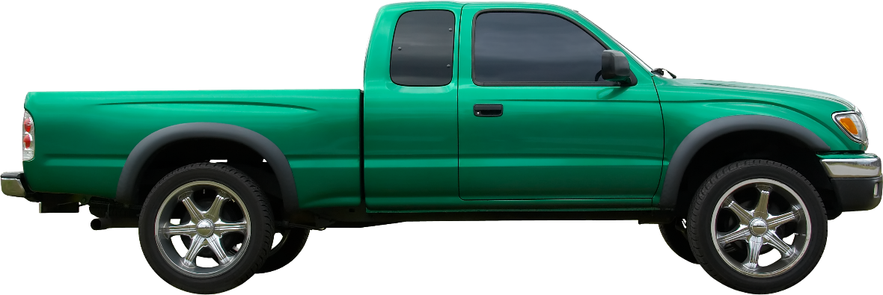
Consider the following…
60 mph
50 mph
Who is right?

Slide 10
There is no absolute speed

Slide 11
There is no universal origin

Slide 12
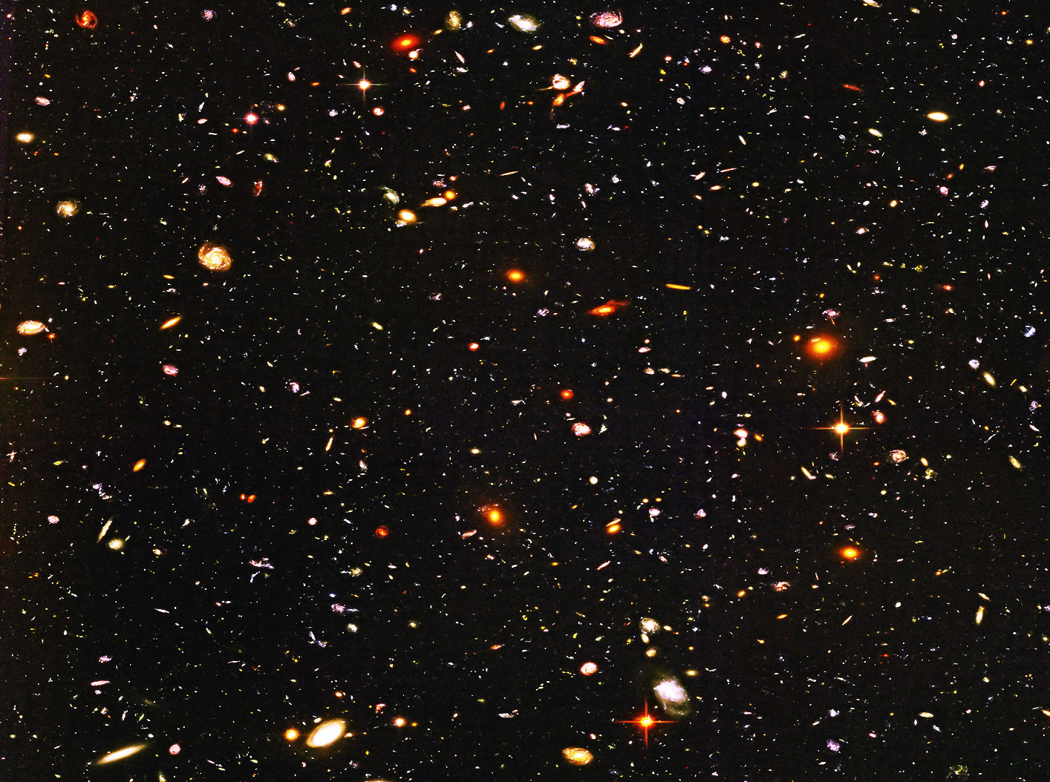
Whether the universe is infinite or not
It definitely doesn’t have a center
Anisotropically expanding objects don’t have centers

Slide 13
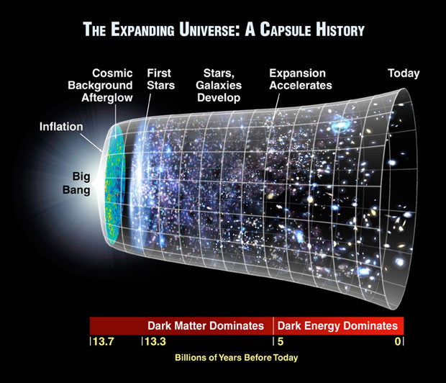
What would it be the center of? Space itself is expanding
What is it expanding into?

Slide 14
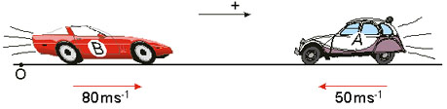
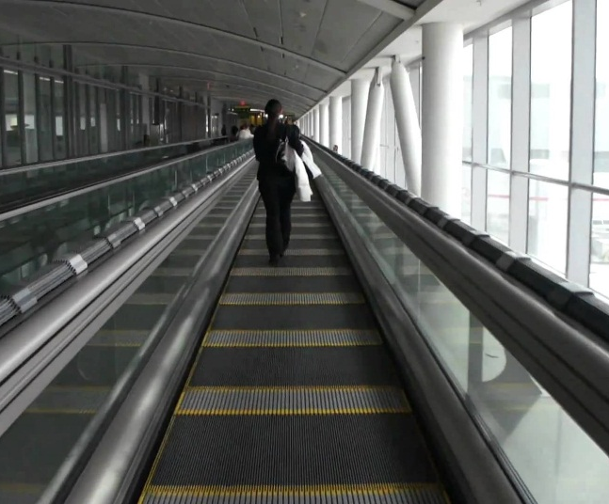
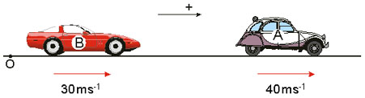
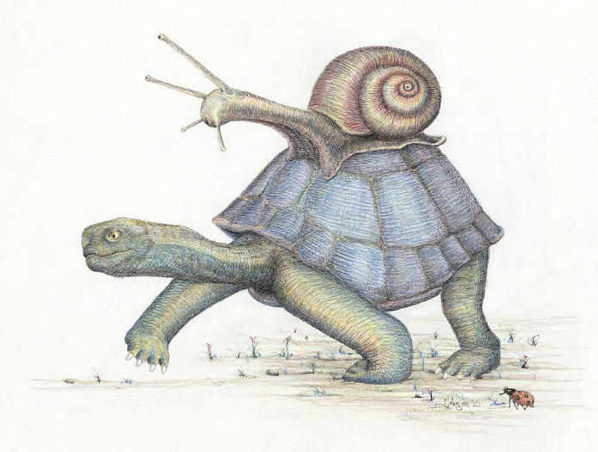
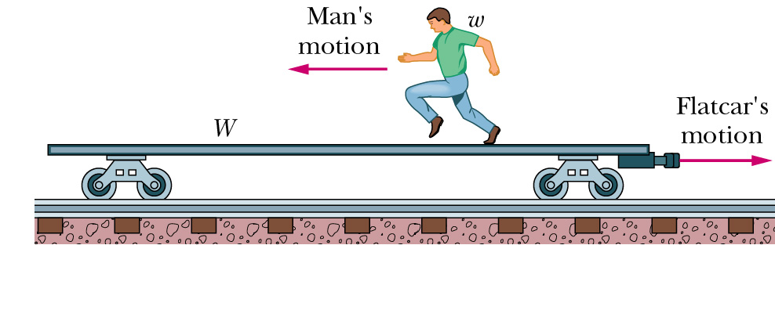
Speed is relative

Slide 15
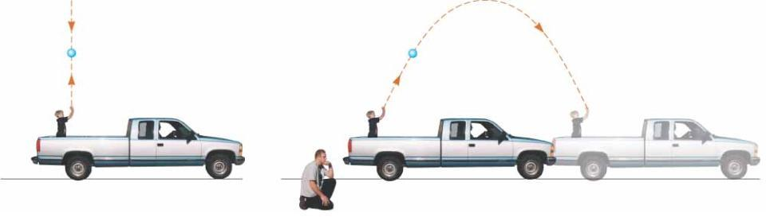
Paths are relative

Slide 16


Position is relative
I’m on the ground so I must have zero potential energy, h=0 right?
Never, I win
Motion is relative

Slide 17
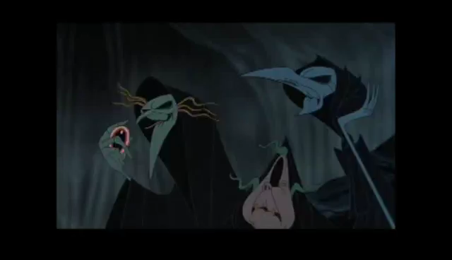
Motion is relative

Slide 18
If everything is relative, how do we do stuff?

Slide 19

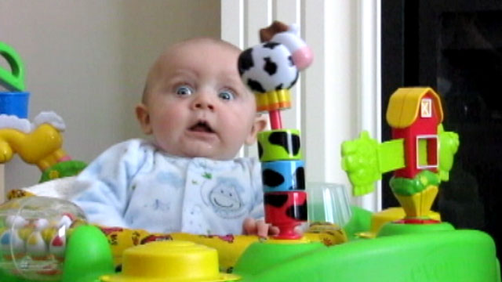
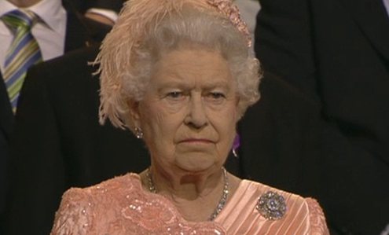







Are you ready?

Slide 20
Today we’re talking about…

Slide 21
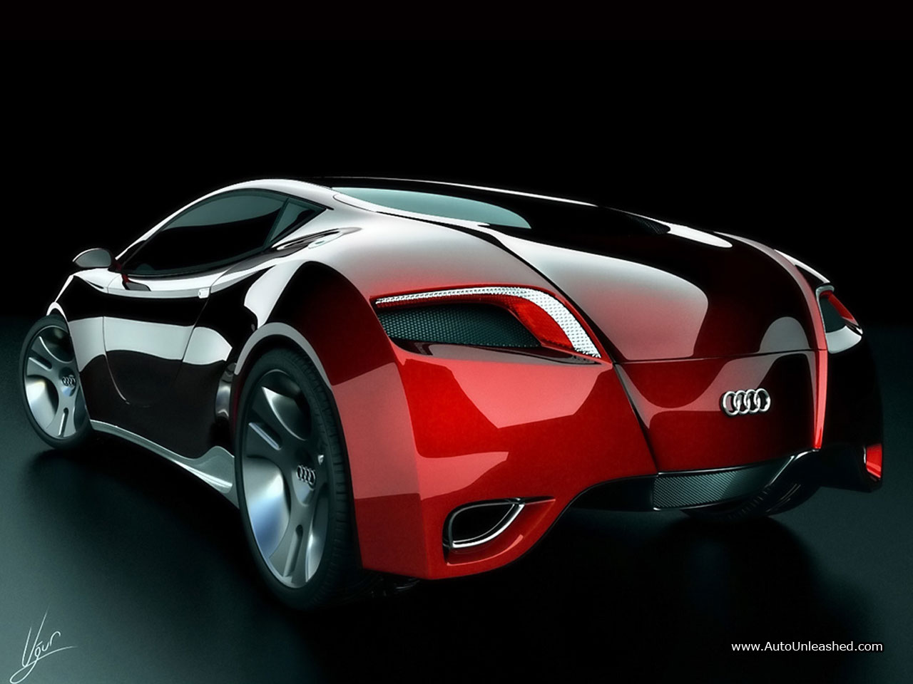
Linear Motion
In 1D

Slide 22


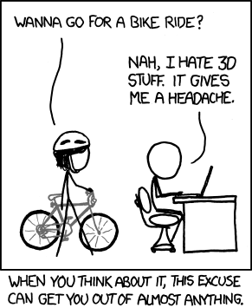
For now, our world looks like this
We can go forward or backwards

Slide 23
How do we describe motion?

Slide 24
Step #1:
Choose a reference frame

Slide 25
Question:
How do we know the trash can is moving?

Slide 26
Position
X

Slide 27
Question:
How do we describe change?

Slide 28
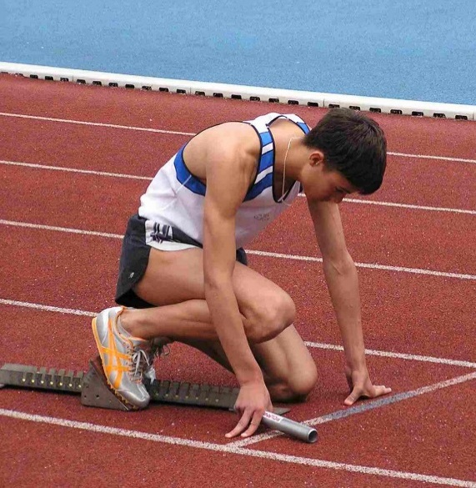
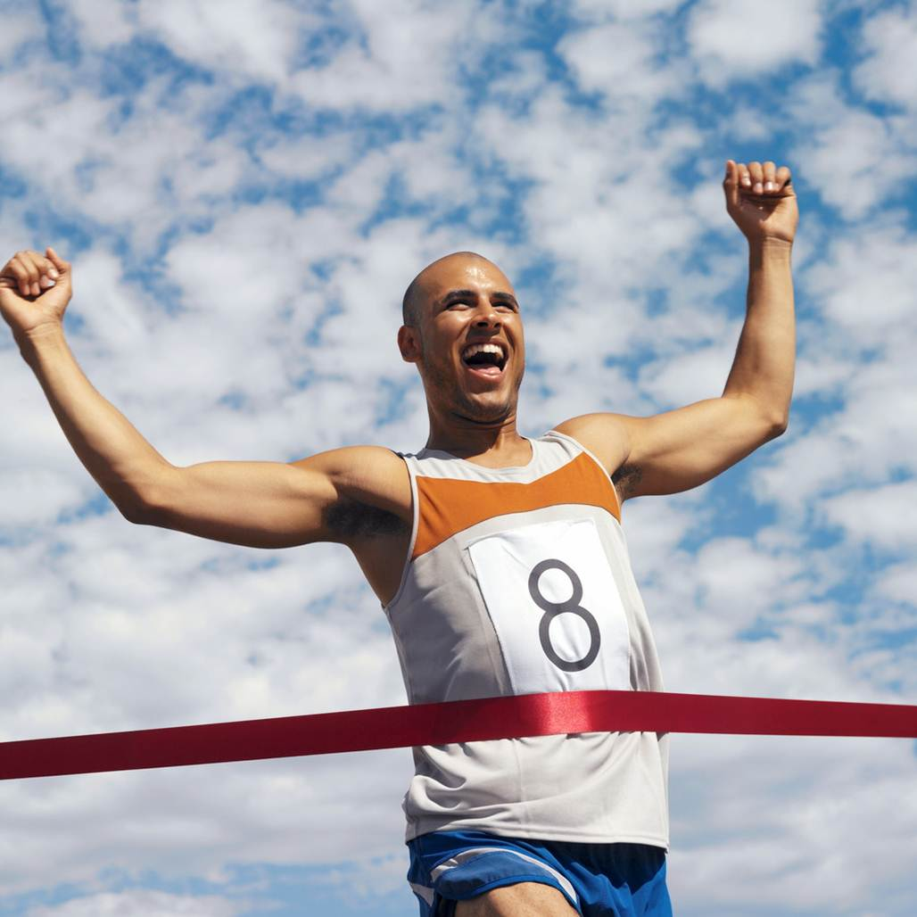
Two Values
Initial Position:
X_{o}
Final Position:
X_{f}

Slide 29

Change
$$Δx=x_{f}−x_{o}$$

Slide 30
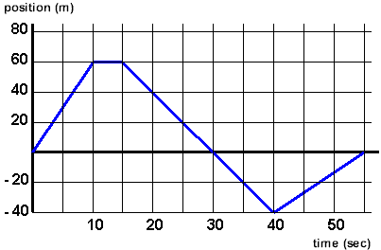
Plot it:
Find x_{o}, x_{f}, and Δx

Slide 31
Question:
How fast are we changing?

Slide 32
How fast is this curve changing?
s _ _ _ _ = r_ _ _ / r _ _

Slide 33
Velocity
V

Slide 34
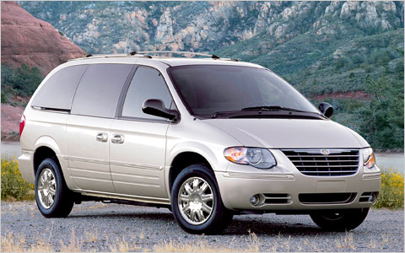
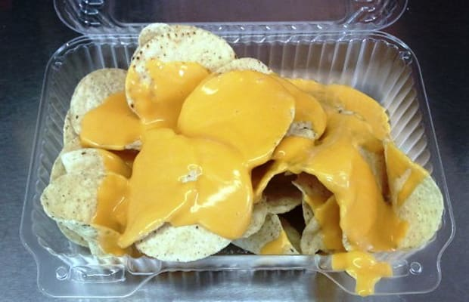

Velocity
$$v=\frac{∆x}{∆t}$$
#average

Slide 35
In general,
X
Is a function of…
Time
X(t)

Slide 36

Velocity for grown-ups
$$v=\frac{dx}{dt}$$
#instantaneous

Slide 37
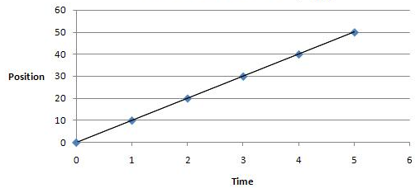
Find the velocity

Slide 38
Velocity is a vector
Which balls are moving forwards? Backwards? The fastest? The slowest?

Slide 39

Question:
What if our velocity is changing?

Slide 40
Question:
How do we describe change?

Slide 41
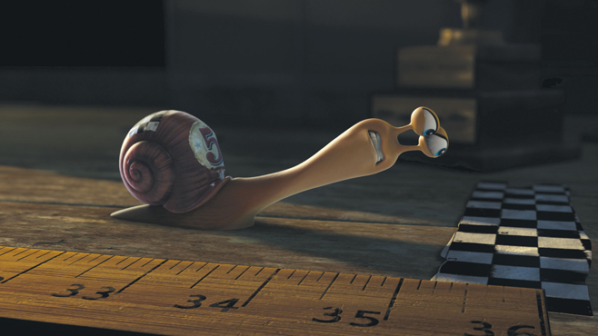
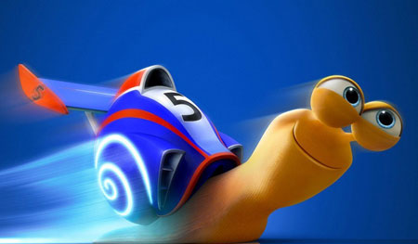
Two Values
Initial Velocity:
V_{o}
Final Velocity:
V_{f}

Slide 42

Change
$$Δv=v_{f}−v_{o}$$

Slide 43
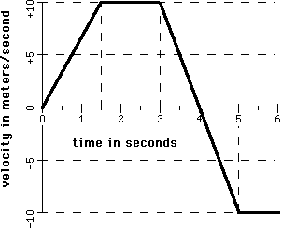
Plot it:
Find v_{o}, v_{f}, and Δv

Slide 44
Question:
How fast are we changing?

Slide 45
How fast is this curve changing?
s _ _ _ _ = r_ _ _ / r _ _

Slide 46
Acceleration
a

Slide 47

Acceleration
$$a=\frac{∆v}{∆t}$$
#average

Slide 48
In general,
V
Is a function of…
Time
V(t)

Slide 49

Acceleration for grown-ups
$$a=\frac{dv}{dt}$$
#instantaneous

Slide 50
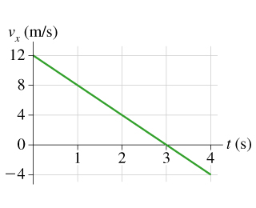
Find the acceleration
Find the displacement

Slide 51
Acceleration is a vector
(assume all balls are moving to the right)
Which balls are speeding up? Slowing down?

Slide 52
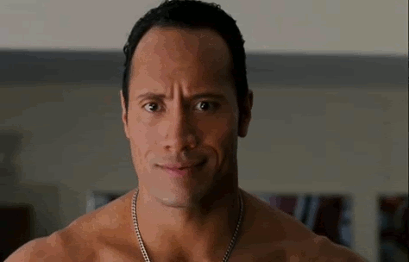
Question:
What if our acceleration is changing?

Slide 53
It’s called jerk
We won’t study it in this class
But you can call your friends 3rd derivatives
We are going to assume constant acceleration

Slide 54
Sample problem:
Draw an x-t graph for an object that isn’t moving.

Slide 55
Sample problem:
Draw an x-t graph for an object moving at a constant velocity.

Slide 56
Sample problem:
Draw an x-t graph for an object moving with a constant acceleration.

Slide 57
Question:
How do we put all of this together and do math and stuff with it?

Slide 58


Try this:
$$a=\frac{dv}{dt}$$
$$dv=adt$$
$$\int{dv}=\int{adt}$$

Slide 59
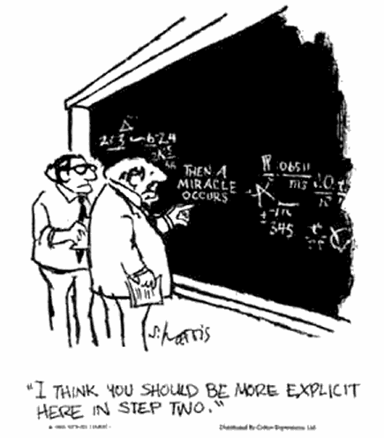
After some Algebra…
We arrive at…

Slide 60
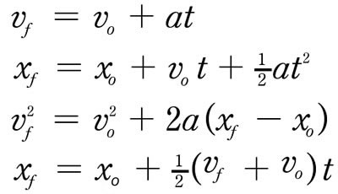
Kinematic Equations

Slide 61

Kinematic FAQ
Question #1:
What are they used for?
Answer #1:
To solve for the 1D motion of objects.

Slide 62
Kinematic FAQ
Question #2:
Why are there 4 of them?
Answer #2:
We have 4 variables.

Slide 63
Kinematic FAQ
Question #3:
How do I know which one to use?
Answer #3:
It depends on what you’re looking for.
#Fundamentaltheoremofalgebra

Slide 64
Sample Problem:
What is the average speed of a rocket that travels 300 meters is 4 seconds?

Slide 65
Kinematic Equations

Slide 66
Sample Problem:
If a car is initially traveling at a speed of 20 m/s and is accelerating at a constant rate of 6 m/s², how long will it take to reach a speed of 40 m/s?

Slide 67
Kinematic Equations

Slide 68
Sample Problem:
How long does it take sound (v=343 m/s) to travel 100 meters?

Slide 69
Kinematic Equations

Slide 70
Sample Problem:
If you run at a constant rate of 6m/s, how far will you have traveled in one hour?

Slide 71
Kinematic Equations

Slide 72
Sample Problem:
You are driving your car down State Street at a constant speed of 15 m/s (33 mph). All of a sudden, a lost cow wonders onto the road 20 meters in front of you. You immediately apply the breaks and your car comes to a stop after 2.6 seconds. Do you hit the cow?

Slide 73
Kinematic Equations

Slide 74
Sample Problem:
After your scare with the cow, you notice in the rear view mirror that you are now being chased by Bigfoot. You immediately step on the gas and begin accelerating at a rate of 6 m/s^2. How long does it take you to get up to a speed of 40 m/s (90 mph, required to escape) if you were traveling at 15 m/s to begin with?

Slide 75
Kinematic Equations

Slide 76
Your turn:
An object is dropped from a height of 3m (10 ft). How long will it take to hit the ground? How fast will it be going when it gets there? (The acceleration of gravity is 9.8 m/s^2)

Slide 77
Kinematic Equations

Slide 78
Your turn:
You are designing a roller coaster for a local theme park. The ride includes a vertical drop in which the car is briefly in free fall (ignore friction). You are informed that, in order for the car to make it safely through an upcoming loop, it needs to achieve a speed of 38 m/s at the bottom of the drop. How high does the drop need to be?

